Slide 1






JavaScript (loop)
www.wscubetech.com

Slide 2
Our Agenda.
What is a loop.
Types Of Loop
Diagram to understand for loop.
www.wscubetech.com

Slide 3
What is loop ?
A loop is used to repeat a block of code until the specified condition is met.
Save time and leads to code reusability.
When similar task is needed to be done again and again.
www.wscubetech.com

Slide 4
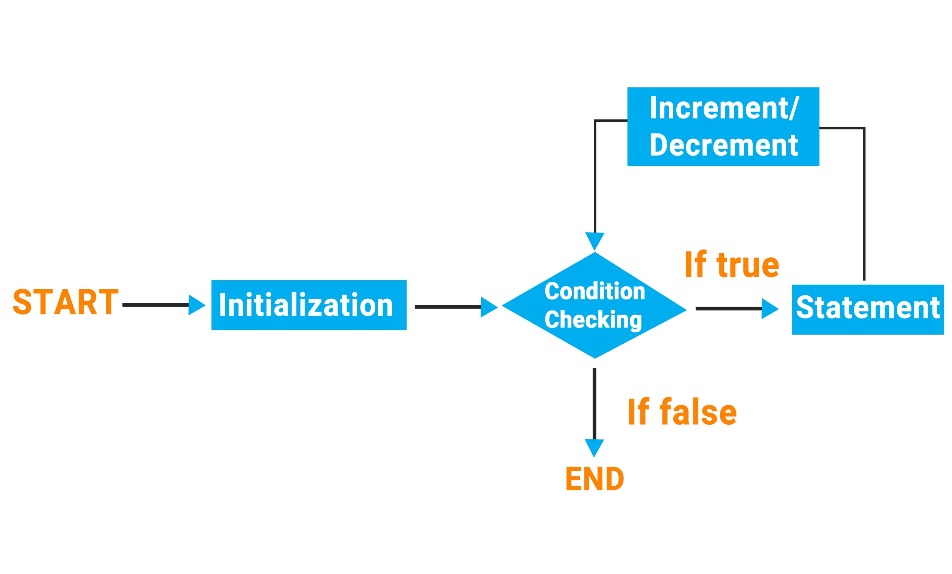
Diagram to understand for loop ?
www.wscubetech.com

Slide 5
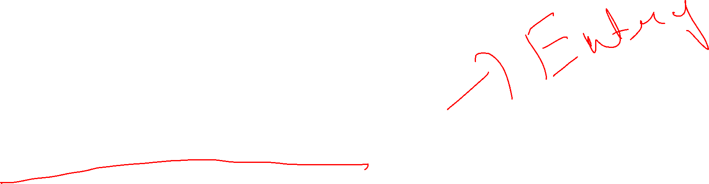
Types Of Loop
for Loop
while Loop
do-while Loop
www.wscubetech.com

Slide 6
for loop in JavaScript ?
test condition
initialization
+ ement/- ement
for(var i = 1; i<=10 ;i++)
{
// Statement(s) to be executed if test
//condition is true
}
www.wscubetech.com

Slide 7
for loop in JavaScript ?
initialization
var i = 1;
while(i<=10)
{
// Statement(s) to be executed if test
//condition is true
i++;
}
test condition
+ ement/- ement
www.wscubetech.com

Slide 8
do-while loop in JavaScript ?
var i = 1;
do
{
// Statement(s) to be executed if test
//condition is true
i++;
}while(i<=10)
initialization
+ ement/- ement
test condition
www.wscubetech.com

Slide 9


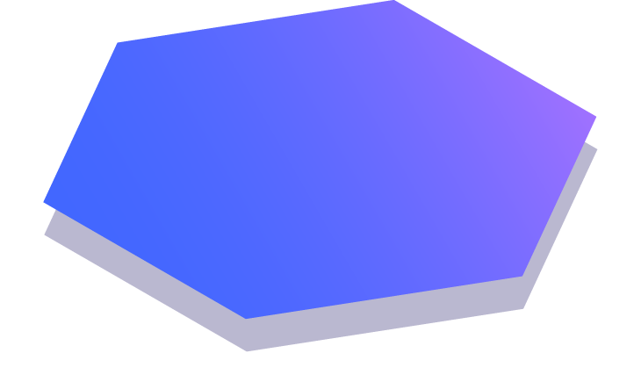
@wscube
@wscubetech.india
www.wscubetech.com
Subscribe To Get Notified about New Videos

